Slide 1
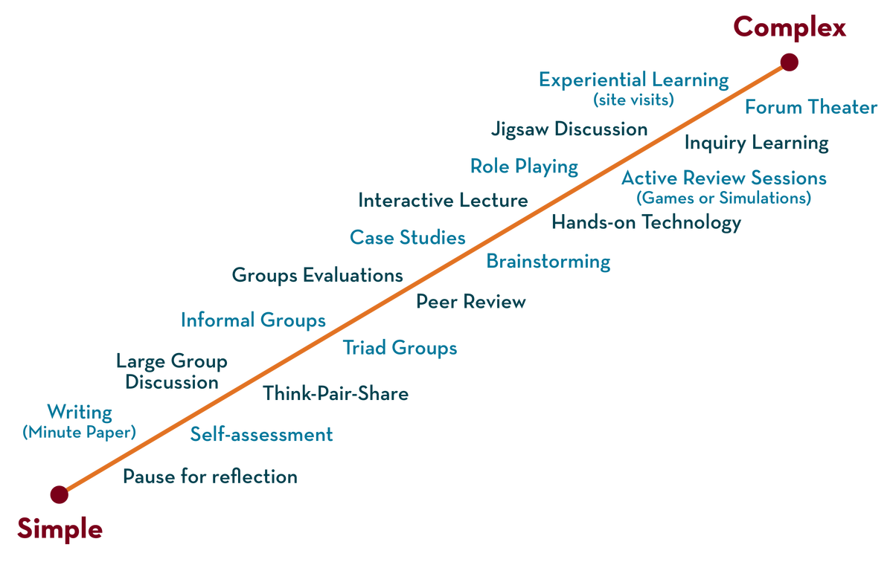

Department of ECE
26EC1202E
Digital Design & Computer Architecture
Exp - 5
Verification of Flip flops

Slide 2
Exp 5: Verification of Flip Flops
Aim
To verify the truth tables of basic flip flops using ICs

Slide 3
Exp 5: Verification of Flip Flops
Apparatus Required:
Hardware:
S.No | Name of the apparatus | Quantity
1 | Digital IC trainer kit | 1
2 | IC 74LS74 (D flip-flop) | 1
3 | IC 74LS76 (JK flip-flop) | 1
4 | IC 74LS00 (NAND Gate IC) | 1
5 | Connecting wires | As per requirement

Slide 4
Exp 5: Verification of Flip Flops
Theory:
Write 1 or 2 paragraphs about the experiment
Procedure:
Connections are made as per the circuit diagram.
Verified the connections carefully and switched on the power supply.
By applying the inputs, the LED outputs are observed and the operation is verified with the help of truth table.

Slide 5
Exp 5: Verification of Flip Flops
Precautions:
Connections must be tight on the bread board.
Identify the pins of the IC properly.
Take care while removing and inserting the IC on bread board.
Switch off the power supply when not required
Result:

Slide 6
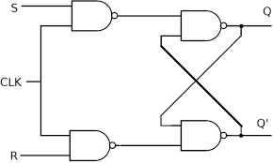
SR Flip Flop using NAND Gates
S
Q
Block Diagram:
R
Q
Truth Table:
Logic Diagram:
S | R | Q (t+1)
0 | 0 | Q (t)
0 | 1 | 0
1 | 0 | 1
1 | 1 | Invalid

Slide 7
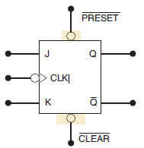
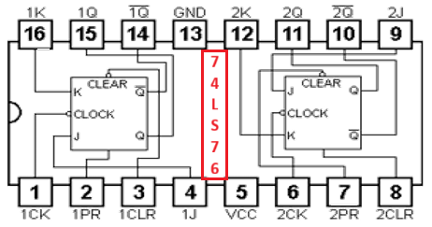
JK Flip Flop using 74LS76 IC
Block Diagram:
Pin Diagram:

Slide 8
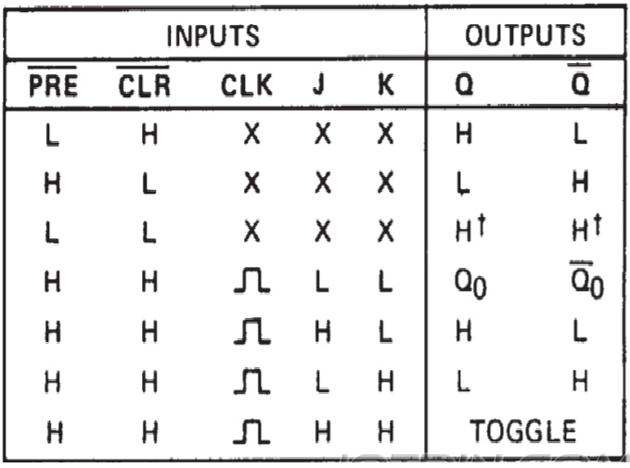
JK Flip Flop using 74LS76 IC
Truth Table:

Slide 9
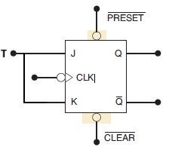
T Flip Flop using JK Flip Flop (74LS76) IC
Block Diagram:
Pin Diagram:

Slide 10
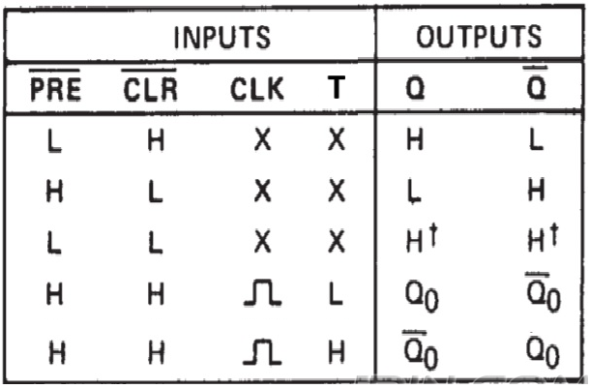
T Flip Flop using JK Flip Flop (74LS76) IC
Truth Table:

Slide 11
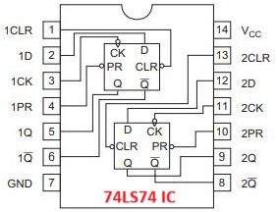
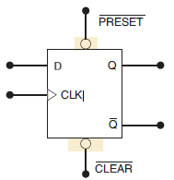
D Flip Flop using 74LS74 IC
Block Diagram:
Pin Diagram:

Slide 12
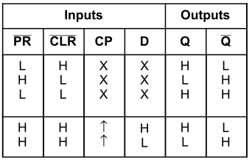
D Flip Flop using 74LS74 IC
Truth Table:

Slide 13
THANK YOU
Team – DDCA

